Slide 1
CTSU Clean Utility Kaizen Report Out
CTSU Staff Meeting
January 12, 2017

Slide 2
Our Team!
Bevonda Ford
Cara Saxton
Edward Booth
Elise Payne
Katie Evans
Melissa Shreve
Monica Aitbelyazid
Olivia Roberts
Tasha Rose
Vanessa Zito
Victoria De lac

Slide 3
Story Without a Storyteller: A3 Thinking

Slide 4
5 S Event
SORT
SET IN PLACE
SHINE
STANDARDIZE
SUSTAIN
LEAN 5S

Slide 5
Box 1: Reason for Action
Problem Statement:
The current system for managing PAR levels and restocking does not represent current supply demands on the floor. The visual management system no longer reflects the categories of items that are put inside of the bins. Staff have a hard time items and if multiple supplies are needed to treat a single problem, a staff person much search through the clean utility room. In addition, overstocking has resulted in staffing needing to spend additional time returning items to Central Distribution; on average 5.75 credit forms must be completed and 18 items per month must be resubmitted to CD.
Importance Statement:
Having easy to find, appropriately located supplies allow staff to meet patient care needs in a timely manner. It also allows for more efficient stocking. In addition, overstocking means that supplies on the floor are not being used leading to unnecessary budget spend and the risk of items expiring.

Slide 6
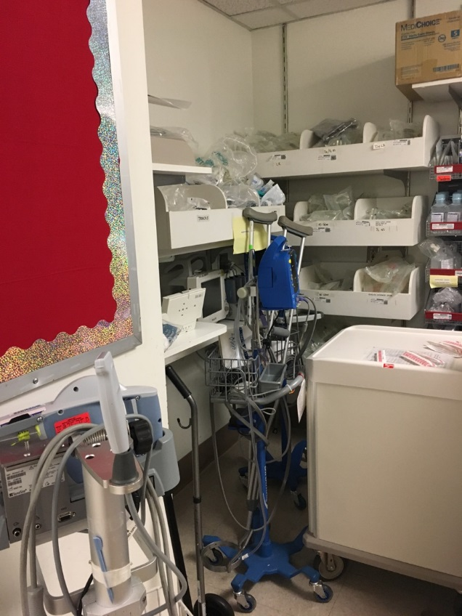
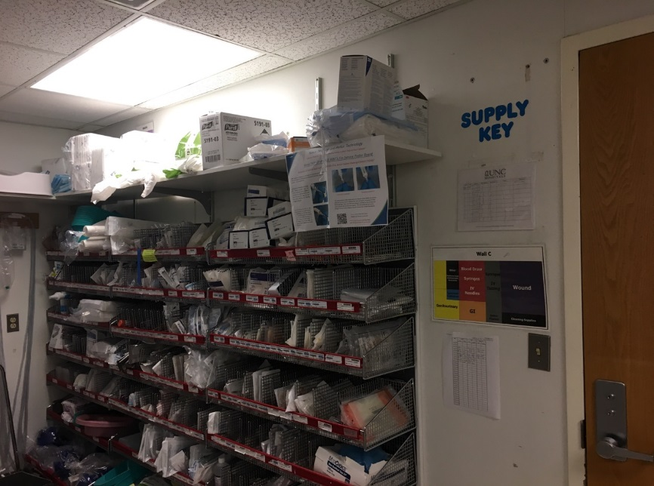
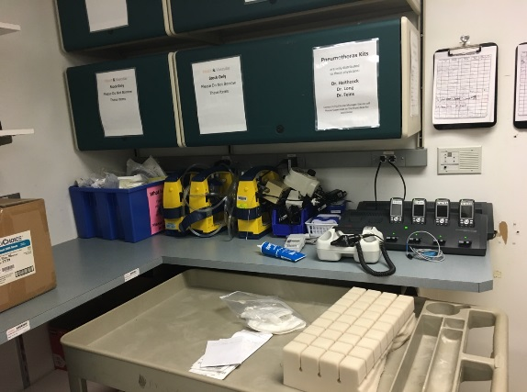
Box 2: Current State

Slide 7
Boxes 2 & 3: Current & Target States
Metric | Unit | Current | Target
Number of CD forms submitted for credit per month | # | 5.75 | 3.00
Average 5S Assessment | MM:SS | 47 | 94
Average time to find item (novice) | MM:SS | 7.20 | 5
Average time to find item (expert) | MM:SS | 5.00 | 5
Find and fix a safety issue | # | 0 | 1
Double the good and halve the bad!

Slide 8
Box 4: Gap Analysis
Gaps | Root Cause
Overstocking | Hard to understand labels without PARs
Overstocking | Not ordering to shift
Overstocking | Carts’ PAR levels not updated
Carts not locking | Carts not being charged
Cart PARs not maintained (over or understocked) | Not designated person to do stocking
Notes:
1 gap with 1 root cause.

Slide 9
Boxes 5 & 6 (Solution Approach & Experiments)
Box 5: Solution Approach
“If we, then we…”
Box 6: Experiments
If we fix our par level, we’ll spend less time looking for items
If we improve the visual management of carts and the clean utility, then we will use them more.
If we rotate the carts location, they’ll be charged more often and will lock properly.
If we order to shift, not to PAR, we’ll reduce overstocking.
5S carts:
Created a cart rotation system to ensure all carts charged and able to lock
Updated PAR levels:
Return items over PAR
Manual in clean utility with PAR levels for stocking
5S clean utility:
Update PAR levels
Throw out expired items & return items over PAR
Remove equipment and items not being used
New labels that include updated PAR levels
Tape floors for equipment homes
Medication manager
PT equipment storage

Slide 10
Box 7: Completion Plan
Items Still in Progress:
Update cart codes
Continue collecting number of credit forms and amount of money and number of items credited per month
*This team was very efficient. It is rare to have such a short “Completion Plan” following an event.

Slide 11
Boxes 8: Confirmed State (for Kaizen) + 30, 60 & 90 Day Meeting Data
Metric | Unit | Current | Target | Kaizen
Number of CD forms submitted for credit per month | # | 5.75 | 3.00 | n/a
Average 5S Assessment | MM:SS | 47 | 94
Average time to find item (novice) | MM:SS | 7.20 | 5 | 7
Average time to find item (expert) | MM:SS | 5.00 | 5 | 5.5
Find and fix a safety issue | # | 0 | 1 | 1

Slide 12
From this….

Slide 13
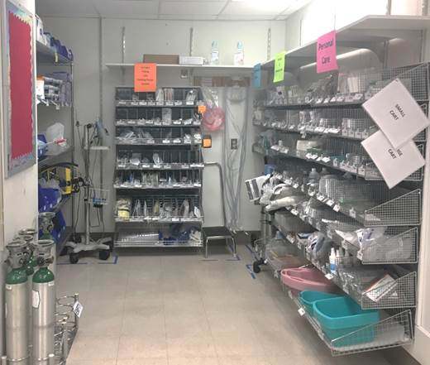
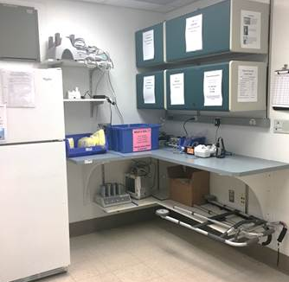
To This!!!
$1,165.43 in Credits Back to CD

Slide 14
Box 9: Insights
CTSU Kaizen team members share their thoughts:
What went well
What they learned
What they hope to use in their role or on their next Lean Improvement Project

Slide 15
What does this mean for me?
Easier to find items in clean utility and carts – able to meet patient care needs faster!
Appropriate PAR levels mean having the items you need.
Less likely to need to return items to CD.
Greater ability to meet the floor’s Med Surg budget.
You have even more “Lean Champions” on your floor to work to improve processes and space.

Slide 16
How can I support this project?
If you have questions ask a team member or another staff member.
Share feedback you have about the changes with Tasha Rose. We meet 30, 60, and 90 days after the event and will continue to incorporate your feedback.
Continue to order to your shift.
If you notice stocking above PAR levels please let Tasha Rose know.

Slide 17
Thank you to all
of the CTSU staff
for your help
and support during
the process!

