Slide 1
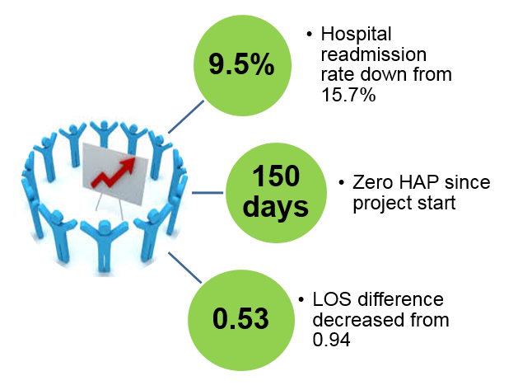
UNC Medical Center Division of Nursing
Interprofessional Collaboration: Improving Pulmonary Hygiene Practices for Thoracic Surgery Patients
Tasha J. Rose, BSN, RN, PCCN; Benjamin Haithcock, MD; Jason Long, MD; Lauren Hill, NP;
Sharonda Jackson, RRT; Devon Beer, PT; Melissa Shreve, MSN, RN, PCCN; Caroline Ornelas, Quality Coach
Cardiothoracic Stepdown Unit
UNC Medical Center Chapel Hill, NC
Background/Problem
Methods & Approach
Execution of pulmonary hygiene has been inconsistent on the Cardiothoracic Stepdown Unit (CTSU). Complications for postoperative thoracic surgery patients include respiratory distress and hospital acquired pneumonia (HAP), which may necessitate transfer to a higher level of care, cause an extended length of stay (LOS), or contribute to hospital readmission.
In addition, adverse patient outcomes affect hospital ratings. UNC Hospitals dropped from a two star to a one star rating on the highly competitive Society of Thoracic Surgery’s (STS) public reporting database for the reporting period July 2015 to December 2017. STS outcome measures include length of stay and discharge mortality.
An interprofessional team discussed components of pulmonary hygiene. Key stakeholders completed a process map for each of the four components and provided input on perceived barriers.
Interventions
Verified correct ambulation orders in EPIC.
Obtained additional chest percussion machines.
Nurse practitioner, physical therapy and respiratory therapy provide ongoing education to nursing staff.
Respiratory therapy assignment reorganized to increase availability to administer nebulizer treatments on CTSU.
RNs use decision tree to navigate patient refusals.
Nursing assistants take vital signs once a shift to allow more time to assist patients with early ambulation.
80% of staff completed Team STEPPs training (including physician service line leaders).
Expectations for pulmonary hygiene added to patient information folder and discussed during patient engagement rounds.
Conclusions & Next Steps
Execution of an inter professional pulmonary project was successful and resulted in improved patient outcomes. More patients gained independence through early mobilization, which was well received by patients and providers.
Our plan is to disseminate this project to new cardio-thoracic nursing staff and for those who float to the unit. In addition, project interventions have been shared with other units within the Heart & Vascular service line.
Results & Findings
Organizational Goals
Goals/Objectives
Decrease patient harm: Thoracic Surgery was recognized at a house wide service line leaders meeting and received a quality improvement award for their efforts in tracking quality metrics and discussing action items at monthly meetings.
Cost effectiveness: Cost of one HAP = $28,000-$40,000 vs.
Cost analysis for interventions = $6,000-$8,000
The goal of this initiative is to improve patient outcomes by increasing completion of pulmonary hygiene. Our objectives are to decrease patient harm, to improve team awareness of barriers to practice improvement, and to establish formal processes to increase the consistency and quality of patient care.
For more information please contact Tasha Rose at Tasha.Rose@unchealth.unc.edu or 984-974-1565
References:
Giuliano, K., Baker, D., and Quinn, B. (2018). The epidemiology of non ventilator hospital-acquired pneumonia in the Unite States. American Journal of Infection Control, 46, 322-327.
The Society of Thoracic Surgeons (2018). STS public reporting online: University of North Carolina Hospitals at Chapel Hill, DOI: https://publicreporting.sts.org/gtsd-participant/40146
Table #. Table Title

