Slide 1


Carolina Care
®
CTSU
Monday Morning Carolina Care Rally
December 4, 2017

Slide 2
Unit Performance
HCAHPS
N= 48 Score 89.6
Press Ganey
N= 49 Score 90.5

Slide 3
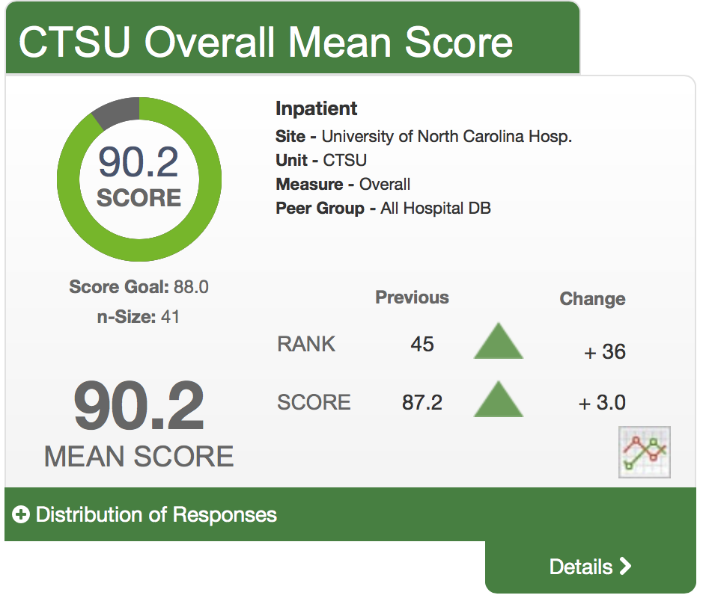
Unit Performance

Slide 4
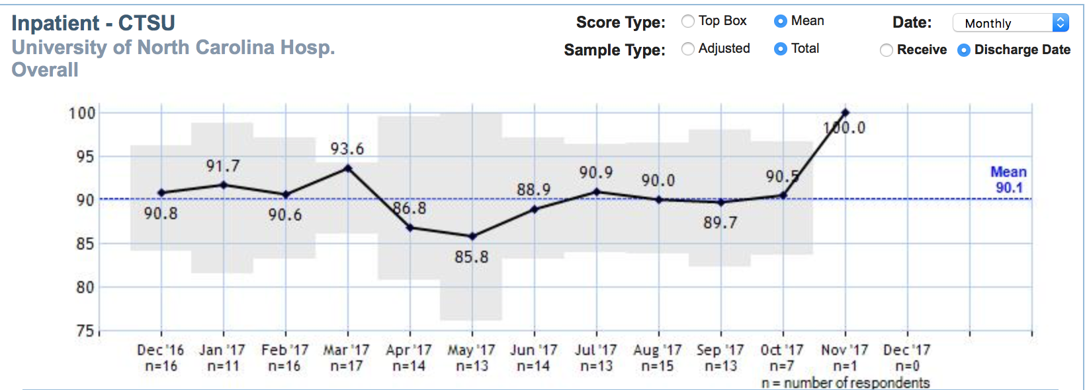
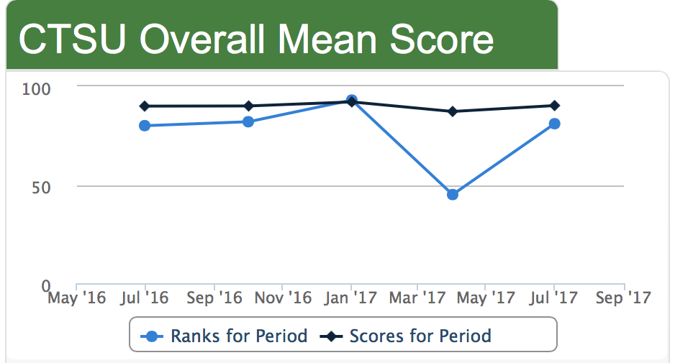
PG Overall Trend

Slide 5
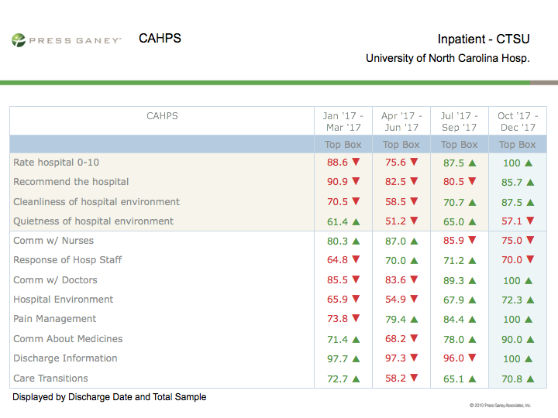
HCAHPS Trends

Slide 6



Unit Highlights/Accomplishments
Earlier shift start time to facilitate interprofessional bedside rounds.
PI & Quality improvement projects reviewed at monthly service line leaders (f.k.a. “Triad”) meetings.
Bi-weekly rounds with EVS; TLC for patient rooms & nurse’s station.
Celebrate with IP team members.

Slide 7
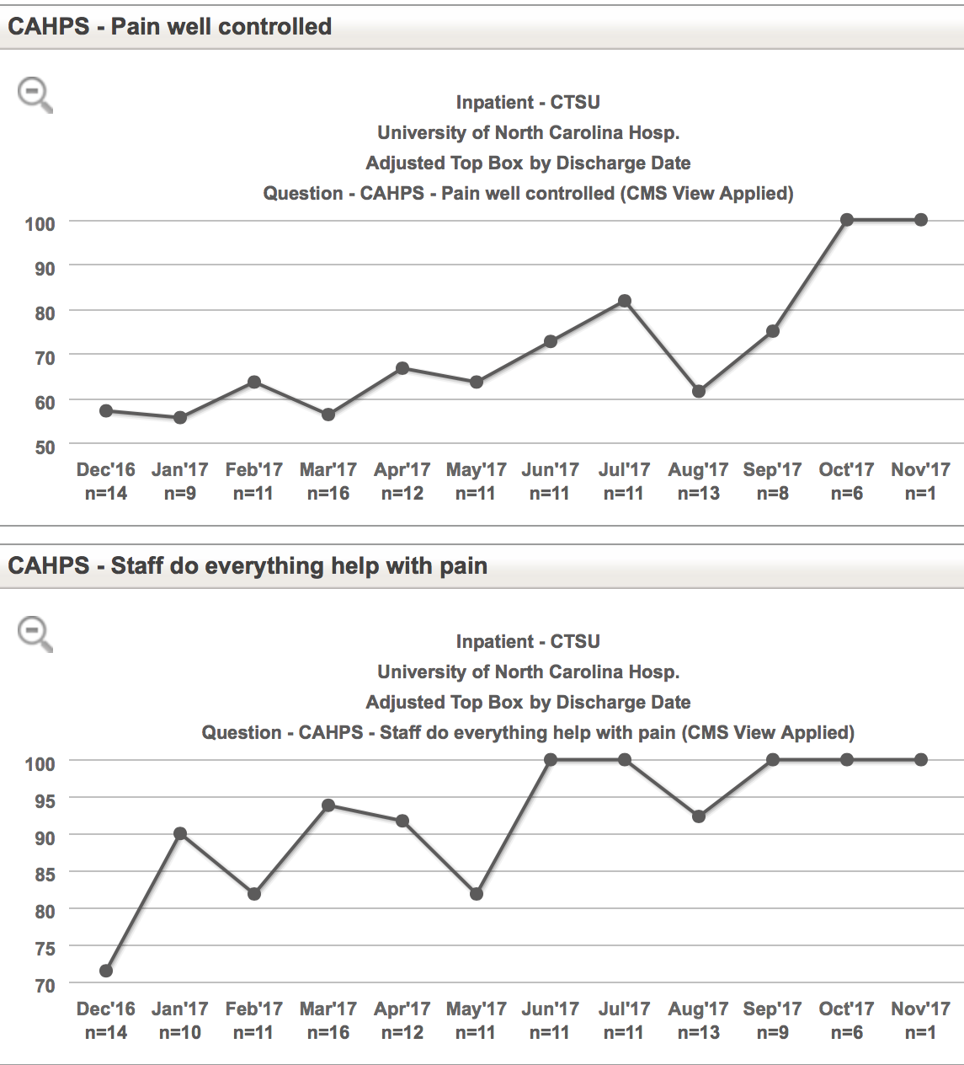
Pain Management-ERAS

Slide 8


Challenges/Brainstorming
Courtesy of the person who served food
Communication with Nurses
Extent felt ready for discharge early mobility initiative
Response of hospital staff responsiveness project
Construction on surrounding units (3AND, 4AND) construction noise reduction/management EWO

Slide 9

Questions?
Thank you for your help in improving patient experience!

